Slide 1
Is Anime Predictable?
A CS4120 Code Walk Presentation
Presented by Brennan Jacobs and Sijie Dai
https://github.com/sijie-daiii/CS4120FinalProject

Slide 2


Background + Dataset
Why Anime?
Anime Pretty Popular
Kaggle had dump of MyAnimeList
https://www.kaggle.com/datasets/dbdmobile/myanimelist-dataset
We used user scores of anime plus anime details to predict what users might be interested in

Slide 3
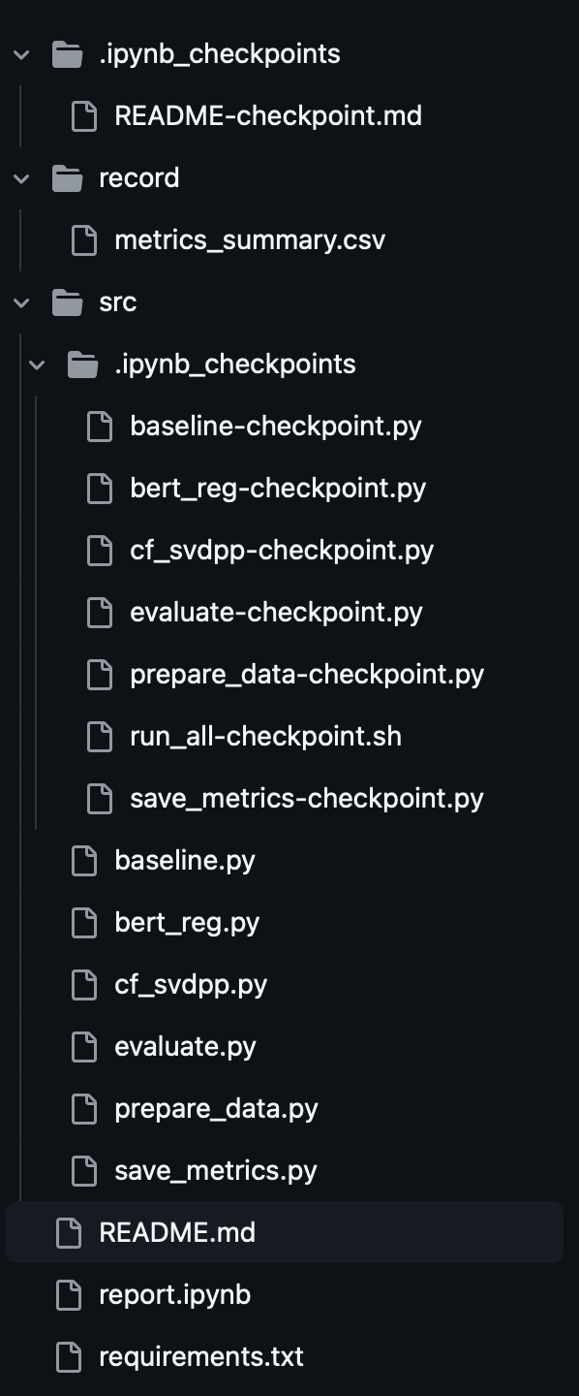
Project Structure and Models
How is the sausage made?
Project structure on right
Model data stored in untracked data folder
Model 1 served as the baseline and just recommended the most popular anime to every user
Model 2 used BERT as a base
Model 3 used an SVD++ model

Slide 4

Helper Files
The Grunts of the Operation
prepare_data.py cleans the dataset
evaluate.py provides helper functions for model evaluation
save_metrics.py saves metrics output
report.ipynb used for dataset metrics

Slide 5
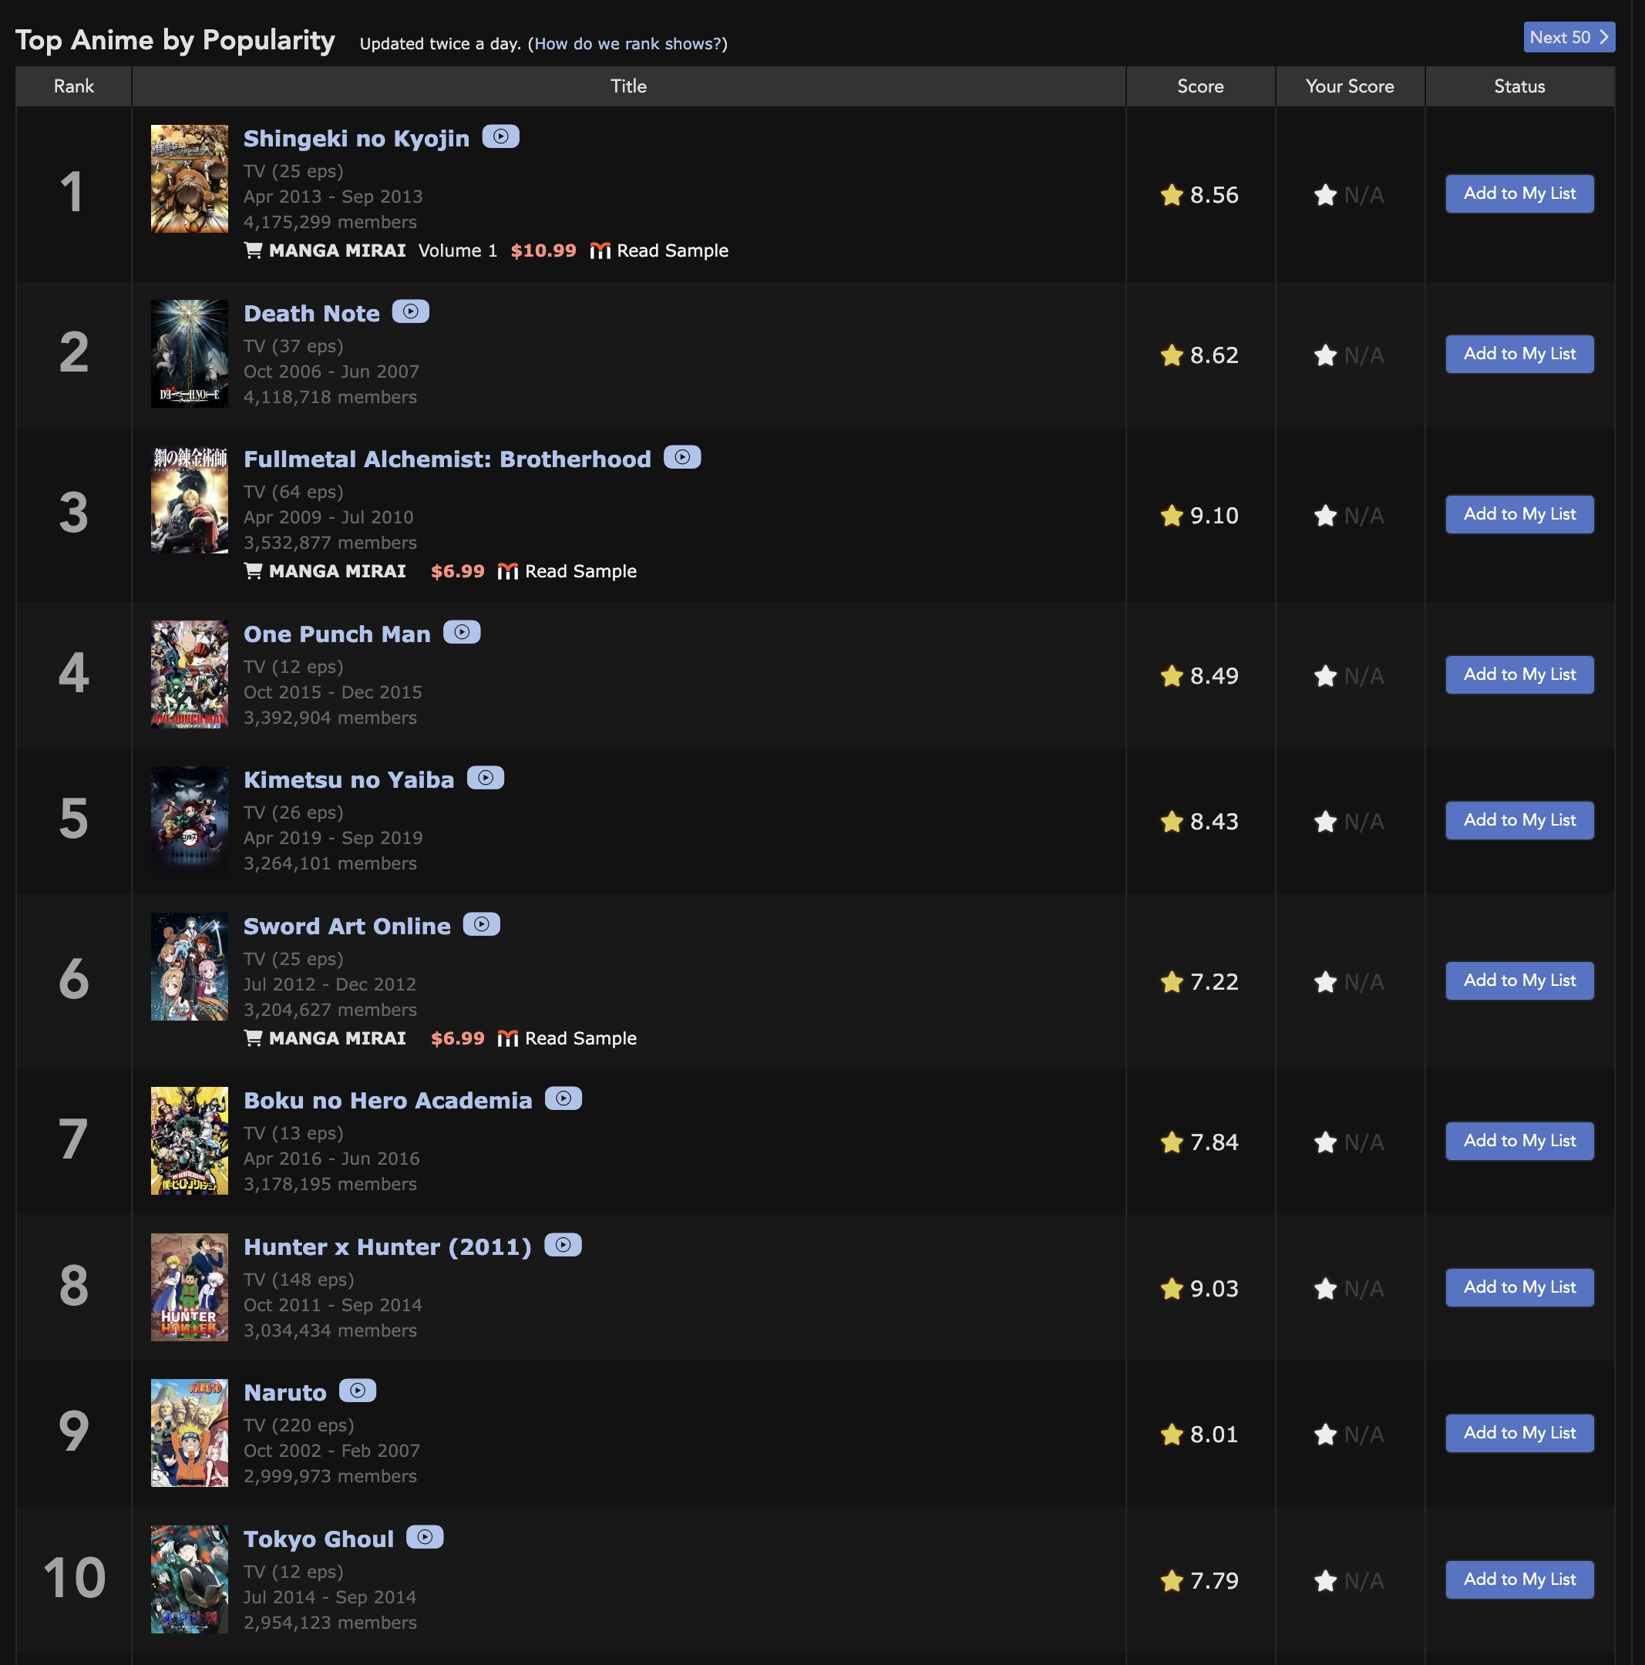
Model 1
Just Watch What Everyone Else Is Watching
In project as baseline.py
Recommends every user the top 10 most popular anime
No training whatsoever
Serves as a baseline for comparison with the other two models

Slide 6


Model 2
Let’s Call it AL
In project as bert_reg.py
Based on bert-base-uncased from transformers.AutoTokenizer
Max length: 256 tokens
Batch size of 8
2 training epochs
LR: $2e^{−5}$
Seed of 42

Slide 7

Model 3
Decompose to Predict
In project as cf_svdpp.py
Based on SVDpp from the surprise library
80 factors
12 training epochs
LR: 0.005
Reg: 0.02
Seed: 42

Slide 8
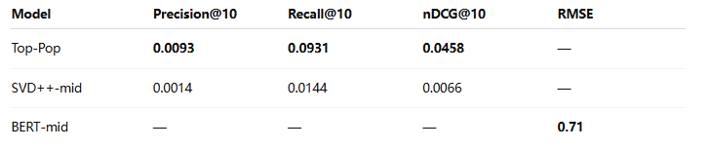
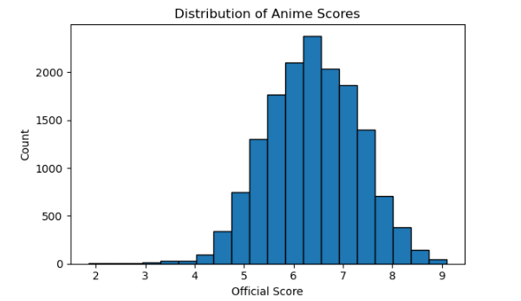
Preliminary Results
“Top-Pop wins on ranking for now—SVD++ trained on 3 % data underperforms; BERT reaches RMSE 0.71.”
The ranking indicator is still the simplest Top-Pop leading; SVD++ is temporarily lagging due to the lack of training data; BERT has achieved a lower error in rating prediction

Slide 9

Future Work
Error analysis – Pick 20 examples of obvious wrong recommendations and label them yourself → See if certain themes/years have become the “blind spots” of the model
BERT rerank – Let SVD++ first pick out the top-30,
then use BERT to score these 30 and re-rank
them → Recalculate nDCG to see if the ranking
has improved
Param sweep – Increase the SVD++ training set
from 3% to 10%, and grid search parameters such as
“hidden vector dimension/regularization coefficient” →
Find the best performing combination

Slide 10
Thank you!
Any questions?

